Slide 1



Slide 2
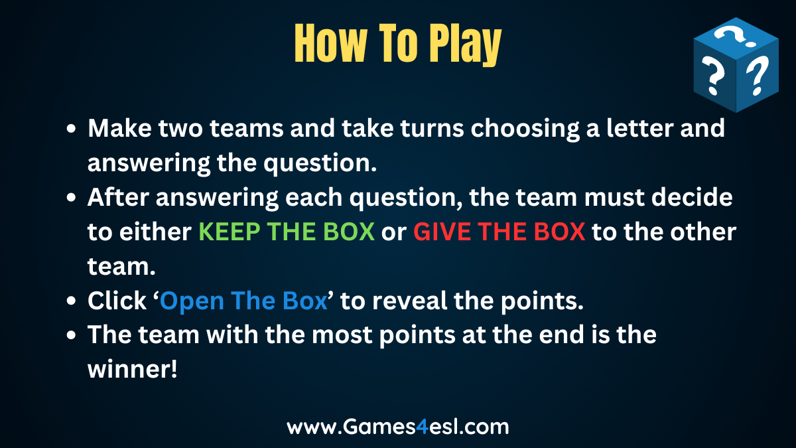

Slide 3



























CHOOSE
A LETTER

Slide 4

Which Surah says to recite the Quran at Fajr?
Bani Israel
2. Al-Kahf
3. Al-Furqan

Slide 5



Slide 6

+50

Slide 7
The first verses that were revealed are from?
Surah Alaq
Surah Fatiha
Surah Ikhlas

Slide 9
-100

Slide 10
What does “Hafiz” (someone who has memorized the Quran) mean?
Guardian
Knowledgably
Protected

Slide 12
-100

Slide 13
What is the meaning of the word “Quran” ?
Recited
Protector
The Guide

Slide 15
+50

Slide 16
Where was the Quran revealed first?
Cave of Hira
House of the Holy Prophet (sa)
Mount Jabal

Slide 18
-100

Slide 19
How many prophets are mentioned by name in the Holy Quran?
A.38
B. 25
C. 17

Slide 21
+300

Slide 22
Which Prophet has been mentioned the most in the Holy Quran?
Hazrat Isa (as)
Hazrat Muhammad (sa)
Hazrat Musa (as)

Slide 24
-30

Slide 25
On whose order was the Qur’an compiled completely in written form?
Hazrat Abu Bakr (ra)
Hazrat Umar (ra)
Hazrat Uthman (ra)

Slide 27
+100

Slide 28
Which companion of the Holy Prophet (sa) is mentioned by name in the Holy Quran?
Hazrat Ali (ra)
Hazrat Sa’ad bin Mua’dh (ra)
Hazrat Zaid bin Harith (ra)

Slide 30
-200

Slide 31
What is the smallest Surah in the Holy Quran?
Al-Kauthar
Al-Asr
Al-Falaq

Slide 33
+1000

Slide 34
Which Surah of the Holy Quran does not begin with “Bismillah” ?
Al-Naml
Al-Furqan
Al-Taubah

Slide 36
+50

Slide 37
The Quran mentions what other name for the city of Medina?
Bilad
Yathrib
Qarya

Slide 39
-50

Slide 40
The Quran was revealed over ____ years.
22-23
16-17
19-20

Slide 42
+50

Slide 43
Which woman’s name is mentioned in the Quran?
Fatima
Ayesha
Maryam

Slide 45
+1

Slide 46
Which Surah of the Quran has the word “Allah” in every verse?
Al-Furqan
Al-Mujadilah
Al-Najm

Slide 48
-1000

Slide 49
When would the angel Jibril (Gabriel) review the whole Quran with the Holy Prophet (sa)?
Right before he (sa) passed away.
Every Eid
Every Ramadan

Slide 51
-300

Slide 52
Was the Quran revealed in the order it is in now?
No
Yes

Slide 54
+200

Slide 55
How old was the Holy Prophet (sa) during the first revelation?
35
45
40

Slide 57
+50

Slide 58
Which Surah is known as “Umm-ul-Quran.” – “The Mother of the Quran” ?
Al-Baqarah
Al-Fatiha
Al-Ikhlas

Slide 60
-100

Slide 61
Ibrahim > Ishaq > Yaqub > ?
Who is Hazrat Yaqub’s (ra) son?
Hazrat Saleh (as)
Hazrat Yunus (as)
Hazrat Yusuf (as)

Slide 63
+20

Slide 64
Who did Hazrat Musa (as) ask Allah to make a prophet along with him?
His brother.
His son.
His nephew.

Slide 66
-100

Slide 67
What was Hazrat Yunus (as) swallowed by?
Sinkhole
Whirlpool
Whale

Slide 69
-20

Slide 70
Hazrat Yusuf (as) saw how many stars doing sajdah to him in his dream?
13
11
9

Slide 72
-100

Slide 73
What does “Al-Ahad” mean?
The Fashioner
The One and Only
The Answer

Slide 75
-100

Slide 76
What does “Al-Qayyum” mean?
The Living
The Provider
The Self-Subsisting

Slide 78
+30

Slide 79
What is the longest Chapter in the Holy Quran?
Al- Baqarah
Al-e-Imran

Slide 81
-1

